Slide 1
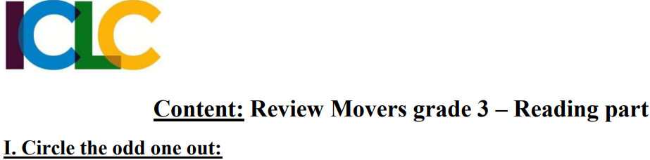
Bao
WRONG
WRONG
RIGHT

Slide 2
Bao
WRONG
RIGHT
WRONG

Slide 3
Bao
WRONG
WRONG
RIGHT

Slide 4
Bao
RIGHT
WRONG
WRONG

Slide 5
Bao
WRONG
WRONG
RIGHT

Slide 6
Bao
WRONG
RIGHT
WRONG

Slide 7
Bao
WRONG
RIGHT
WRONG

Slide 8
Bao
WRONG
WRONG
RIGHT

Slide 9
Bao
WRONG
WRONG
RIGHT

Slide 10
Bao
WRONG
RIGHT
WRONG

Slide 11
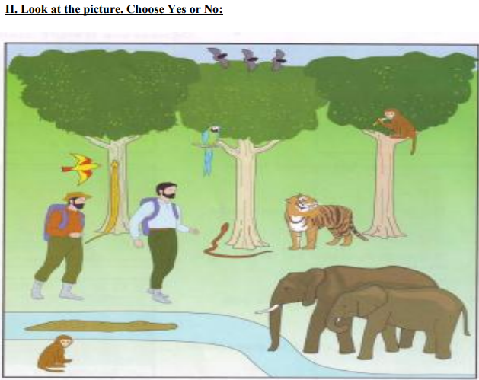

RIGHT
WRONG
WRONG
WRONG
WRONG
WRONG
WRONG

Slide 12
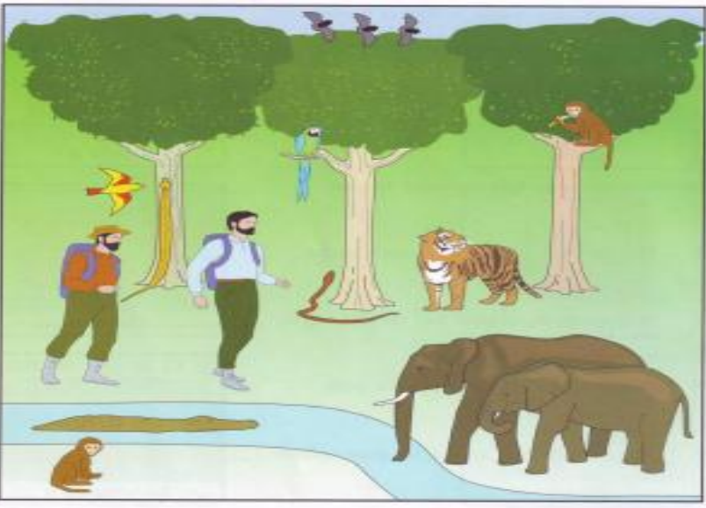
RIGHT
WRONG
Hey! What’re you doing?
WRONG
WRONG
A. Yes B. No
WRONG
WRONG
WRONG

Slide 13
RIGHT
WRONG
I don’t like this tree
WRONG
WRONG
A. Yes B. No
WRONG
WRONG
WRONG

Slide 14
WRONG
WRONG
WRONG
I’m alone!
A. Yes B. No
WRONG
WRONG
RIGHT
WRONG

Slide 15
RIGHT
WRONG
WRONG
A. Yes B. No
WRONG
WRONG
WRONG
WRONG

Slide 16
RIGHT
We’re flying on the tree
WRONG
WRONG
A. Yes B. No
WRONG
WRONG
WRONG
WRONG

Slide 17
RIGHT
WRONG
I hasn’t got a hat
WRONG
WRONG
A. Yes B. No
WRONG
WRONG
WRONG

Slide 18
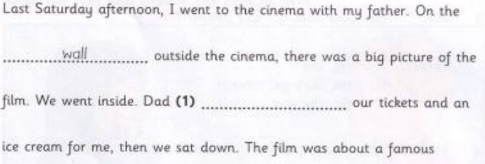

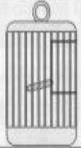
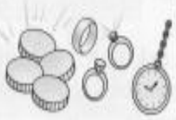
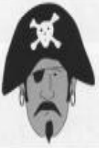
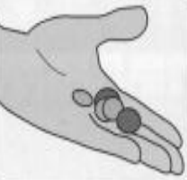
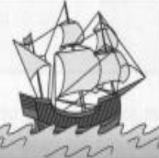
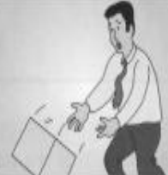
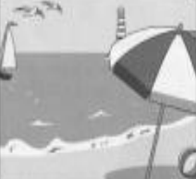

RIGHT
WRONG
WRONG
?
WRONG
wall
treasure
bought
cage
drop
pirate
sailed
look
beach
WRONG
WRONG
WRONG

Slide 19
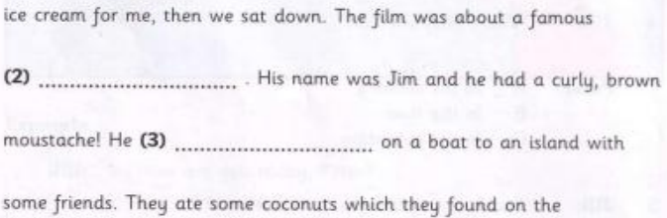
RIGHT
WRONG
?
WRONG
WRONG
wall
treasure
bought
cage
drop
pirate
sailed
look
beach
WRONG
WRONG
WRONG

Slide 20
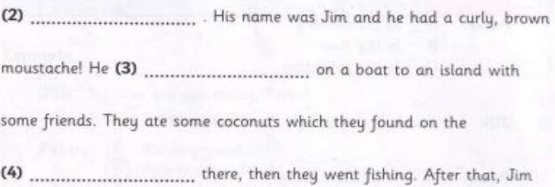
RIGHT
WRONG
?
WRONG
WRONG
wall
treasure
bought
cage
drop
pirate
sailed
look
beach
WRONG
WRONG
WRONG

Slide 21
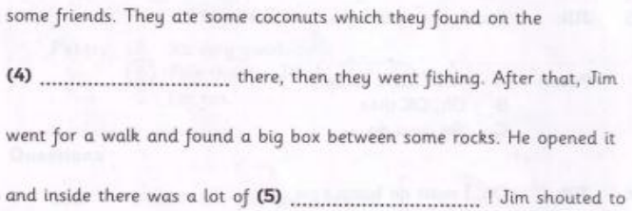
RIGHT
WRONG
?
WRONG
WRONG
wall
treasure
bought
cage
drop
pirate
sailed
look
beach
WRONG
WRONG
WRONG

Slide 22
RIGHT
WRONG
WRONG
?
WRONG
wall
treasure
bought
cage
drop
pirate
sailed
look
beach
WRONG
WRONG
WRONG

Slide 23
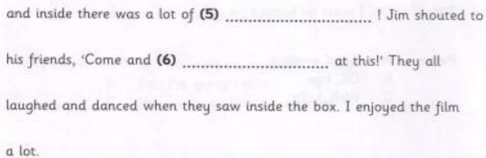
RIGHT
WRONG
?
WRONG
WRONG
wall
treasure
bought
cage
drop
pirate
sailed
look
beach
WRONG
WRONG
WRONG

